Slide 1
Digital Literacy
Fake News, Data Privacy, and Social Media in the Classroom

Slide 2
Daily Media Use
(Common Sense Media, 2015)
Notes:
This report by Common Sense Media

Slide 3
What is digital literacy?
“The ability to use information and communication technologies to find, evaluate, create, and communicate information, requiring both cognitive and technical skills.” (ALA)
Notes:
This definition is provided by the American Library Association. This definition dates back to 2015 and has shifted somewhat to focus on the evaluation component. Literacy is differentiated from technological proficiency. You don’t need to be a tech-guru to have a high level of digital literacy or teach digital literacy.

Slide 4
What is digital citizenship?
Digital citizenship refers to how one interacts with the digital world. It takes into account the psychological, social, and moral components related to digital life.

Slide 5
Changing definitions for an advancing field
Some argue that digital citizenship is simply good citizenship.
These terms will continue to overlap, flex, grow, and contract.
Notes:
Some argue that digital citizenship is simply good citizenship. If so, it relates directly to how we teach broader citizenship. Our lives are wrapped up in the digital world to the point where it’s hard to consider life without digital technologies. The term digital may drop off in the future because it replicates an outmoded dichotomy between analog and digital. The digital world is such a part of our lives that it may no longer make sense to differentiate between the two.
These topics are really important for our students. Social media and digital life in general have an enormous impact on everyday life. We need to play a part in shaping this future.

Slide 6
Facts and Figures

Slide 7
Popular social media
Notes:
Information from Pew Research. Notably, Facebook fell from 2015. It was at 71% now at 51%. And among these social media sites, according to a recent UK study reported on by the BBC, Instagram is the worst for young people’s mental health. It triggers feelings of “inadequacy and anxiety.” What do people tend to post about on Instagram?
Imbalanced portrayals of people.

Slide 8
Popularity tracked
Notes:
This information is for all users.

Slide 9
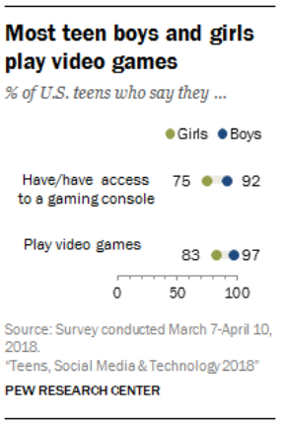
Teen internet use and gaming
Notes:
45% of teens say they use the internet “almost constantly,” a figure that has nearly doubled from the 24% who said this in the 2014-2015 survey.
Half of teenage girls (50%) are near-constant online users, compared with 39% of teenage boys.

Slide 10
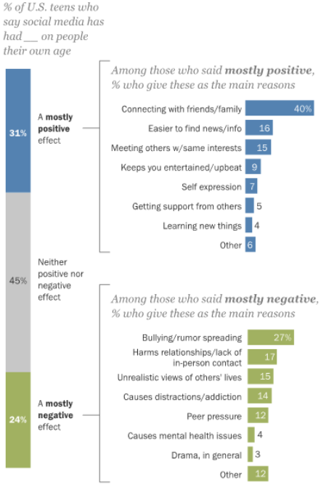
Teens and Social Media
Notes:
Here are some of the responses recorded by Pew Research:
Positive:
“I feel that social media can make people my age feel less lonely or alone. It creates a space where you can interact with people.” (Girl, age 15)
“It has given many kids my age an outlet to express their opinions and emotions, and connect with people who feel the same way.” (Girl, age 15)
“[Social media] allows us to communicate freely and see what everyone else is doing. [It] gives us a voice that can reach many people.” (Boy, age 15)
“We can connect easier with people from different places and we are more likely to ask for help through social media which can save people.” (Girl, age 15)
Negative:
“Gives people a bigger audience to speak and teach hate and belittle each other.” (Boy, age 13)
“People can say whatever they want with anonymity and I think that has a negative impact.” (Boy, age 15)
“Because teens are killing people all because of the things they see on social media or because of the things that happened on social media.” (Girl, age 14)
“It makes it harder for people to socialize in real life, because they become accustomed to not interacting with people in person.” (Girl, age 15)
“It provides a fake image of someone’s life. It sometimes makes me feel that their life is perfect when it is not.” (Girl, age 15)
“[Teens] would rather go scrolling on their phones instead of doing their homework, and it’s so easy to do so. It’s just a huge distraction.” (Boy, age 17)

Slide 11
Modeling healthy behavior
By utilizing social media in the classroom, we model good behavior.

Slide 12
Social media ideas
Tweeting from the perspective of historical characters (popular).
Create and share videos, podcasts, other media.
Work on projects with other classes globally.
Create a Wiki on a topic.
Create polls and share results.
Videoconferencing.
Notes:
Have you used any of these? What worked about? What didn’t work?

Slide 13
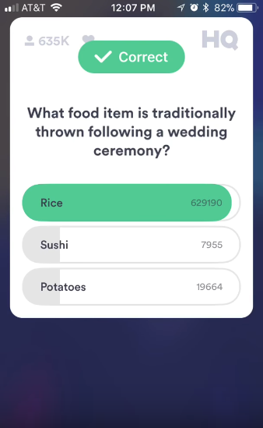
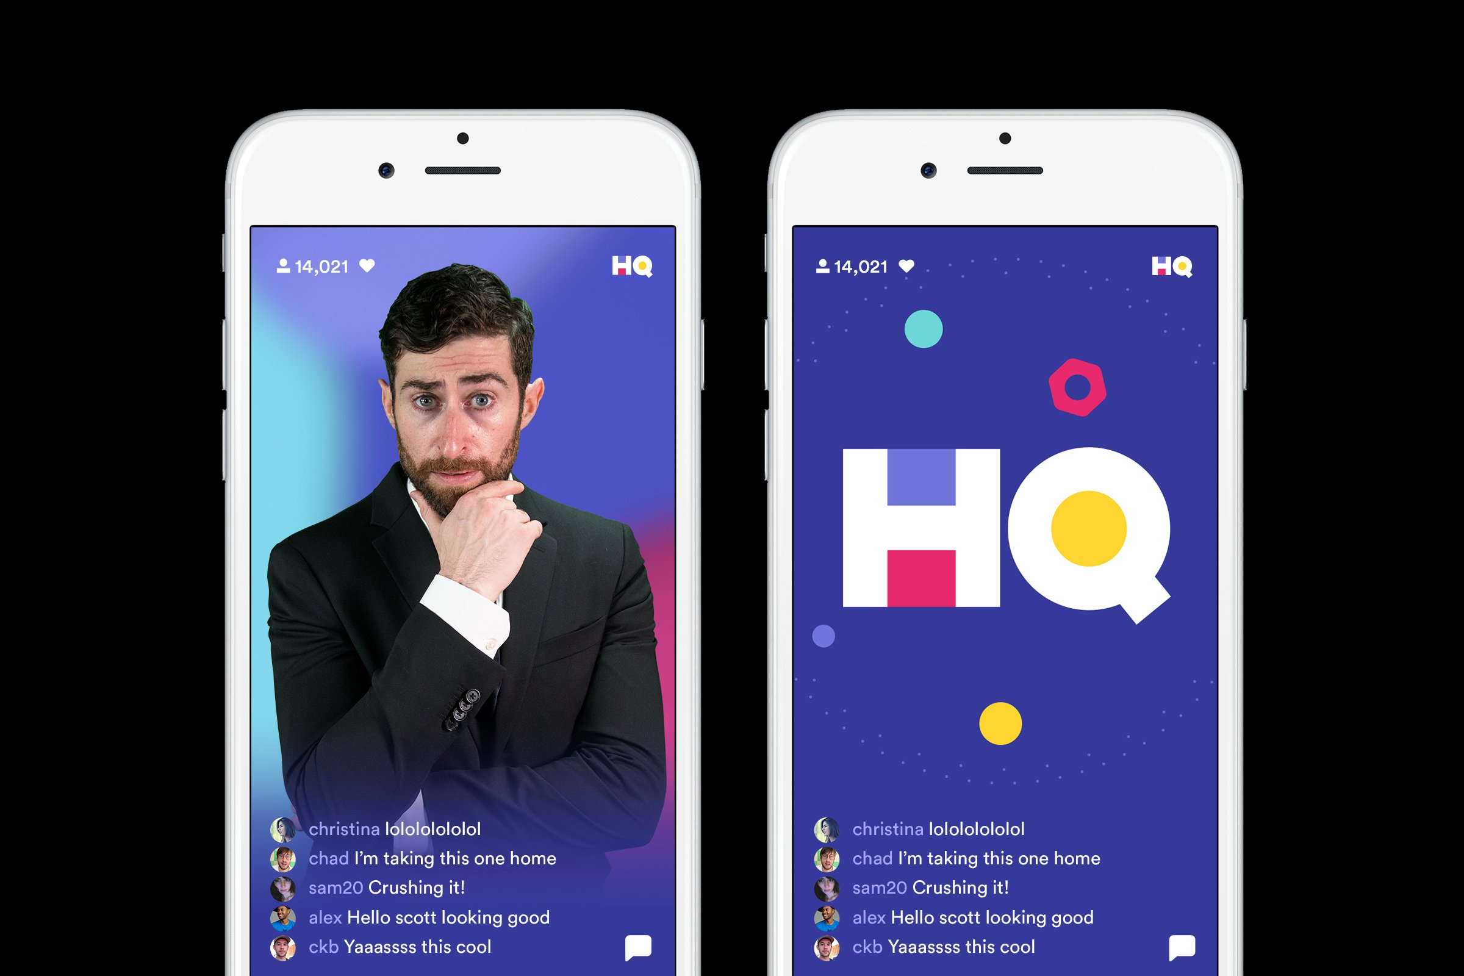
HQ
Notes:
You’re probably familiar with this. Really popular with our students. Happens at 3:00 PM every day.
Why do you think HQ is appealing?

Slide 14
YouTube Live
Students already have accounts through G Suite.
Offers private, low-latency streaming.
Little set-up required.
Push notifications.
Notes:
Some of these features can be replicated. YouTube Live is a possible (and free) option.

Slide 15
Fake News

Slide 16
Fake News
News that is presented as factual while not being based on facts.
Digital literacy means knowing how to detect fake news and its consequences.
Example: Good Samaritan stops terrorist attack.
Newsfeed vs. Explore feed
Echo chamber
Notes:
In Slovakia: “The story claimed that a Muslim man had thanked a good Samaritan for returning his lost wallet, and had warned the Samaritan of a terrorist attack that was planned at a Christmas market.” Police issued statement that it wasn’t true. However, it was buried in the Explore feed.

Slide 17
Investigating Fake News
Look at the source.
Read beyond clickbait titles.
Does the article provide sources?
Check the date.
Is it satire?
Your life-savers:
Snopes.com
FactCheck.org
Notes:
Is it trustworthy? Does it have an “About” page? What are its affiliations? What are other people saying about it?

Slide 18
Fake News?
Was Mr. Rogers a Navy Seal?
https://www.snopes.com/fact-check/fred-rogers-rumors/
Is Amazon costing the USPS “billions of dollars annually?”
https://www.factcheck.org/2018/04/video-trump-on-amazon/
Does iron rust your brain?
https://articles.mercola.com/sites/articles/archive/2018/05/24/how-excess-iron-raises-alzheimers-risk.aspx

Slide 20
Data Privacy

Slide 21
Data privacy
Digital citizenship means caring about how data is collected and used.
Companies profit from selling and using your data.
Cambridge Analytica scandal most recent.

Slide 22
Facebook scandals
Cambridge Analytica fiasco not the first Facebook data scandal. Public memory is short-lived.
Cambridge Analytica: 2014-2016
User influence experiments: 2014
Application privacy leak: 2010
Quit Facebook Day: May 31, 2010.
#deleteFacebook
Facebook usage increased by 7% from April 2017 to April 2018.

Slide 23
Data brokers
Data brokers sell your information to businesses, advertisers, and governments.

Slide 24
Data sources/Data mining
Common sources:
Government records
Not so anonymous data
Smartphone applications
Other sources:
Banks
Social websites
(even if you don’t have an account)
Notes:
Government records include DMV records. Also, voting information like party affiliation are provided to qualified 3rd parties who act as a link for other parties to gain access to your information. Smartphone applications require extensive privileges. For example,

Slide 25
Common Info
Name, age, gender
Addresses, phone numbers, email addresses
Marital status, identities and names of children
Political beliefs, income, education
Genetic information
23andme, ancestry.com, UK National DNA Database (5.86 million records), etc.
Notes:
Disclaimer about genetic information: can’t be sold in the US. Needs to be anonymous. However, as seen with the Facebook issues, this anonymity not always guaranteed and easily compromised. The UK database was compromised in 2007 by industrial servants to start a rival firm though they were eventually caught. Not just adults – 150,000 children in 2007. Almost anything can get you added to the UK National DNA Database ranging from theft to public intoxication to taking part in an illegal political demonstration.

Slide 26
How is this data used?
Streamlining business.
Making better decisions (and measuring impact).
Innovation.
Targeting advertisement and sales.
Infomediate.
Exploit asymmetries.
Notes:
Targeted advertisements are a big player.

Slide 27
Top unethical data uses
Exploit psychological vulnerabilities.
Influence political outcomes (e.g., Cambridge Analytica) and shape public attitudes.
Employ undue influence on global markets.
Profile and discriminate.
Notes:
These are just a few known unethical data uses. Many others are For profiling and discrimination, it’s worth noting that in 2007, black men made up 40% of the UK’s national database while representing about 3.5% of the population. These data uses represent the top, known unethical uses of data.

Slide 28
We should try to understand how data can be used (and is being used) for unethical purposes.
Notes:
By participating, we can shape the direction of data usage.

Slide 29
Black Mirror
Notes:
I’m going to show you a clip from the Netflix show Black Mirror. The episode is called Nosedive. Warning: language.

Slide 31
Social Credit System
Not science fiction:
Proposed by China.
Target date is 2020.
Already in place: Honest Shanghai
Uses government information.
Looks at financial information, jaywalking, garbage sorting, not paying for train tickets, etc.
Notes:
Meant as a way to determine individual’s political beliefs, ability to perform well in business, whether individuals should have access to certain rights like free travel or private education, etc.

Slide 32
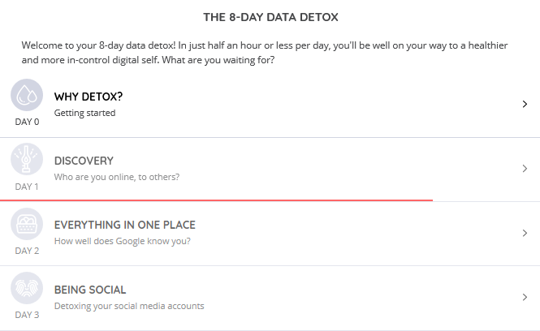
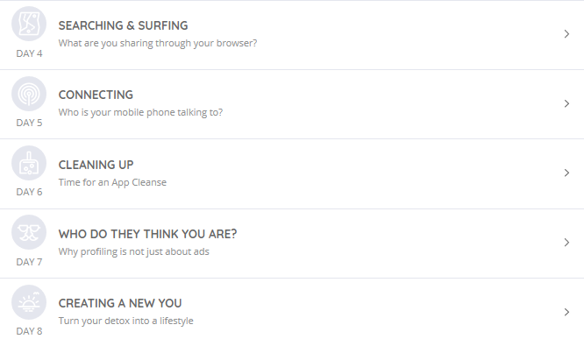
The 8-Day Data Detox

Slide 33
Location tracking

Slide 34
Google’s My Activity page

Slide 35
Day 1
Search your name on Google.
Click on images.
Search by image.
Can you delete it?
Remove it yourself.
Ask someone to remove it.
“Right to be forgotten” request.
https://bit.ly/2t2317u
Notes:
The right to be forgotten request only applies to EU citizens.

Slide 36
Salient points
Digital literacy is “the ability to use information and communication technologies to find, evaluate, create, and communicate information, requiring both cognitive and technical skills.”
Digital citizenship is how one interacts with the digital world.
Social media use is changing.
Fake news is spreading.
Your data is being used without your consent.
We can model healthy behavior.

Slide 37
Questions for discussion
What did you find interesting in this presentation?
Did anything surprise you?
Why are these topics important?
Is there anything else you would like to add?

